Slide 1
An Introduction to Elegant Bizarreness
(Quantum Computing)

Slide 2
Why even bother?
Moore’s law is slowing down!
Dire need for high computing power
Simulating complex molecules
We need physics to make our communications secure
vv fast
Much faster than classical computers in SOME cases. Not all.
And finally…
Is kul

Slide 3

Meme
I am speed

Slide 4
Computing (“Hmm, I think I know what this is”)
+
Quantum (0_0)

Slide 5
What is computing?
What does it mean to “compute” something?
Does it come at a cost?
Is it a physical process?
Can we quantify the outcome of computing something?

Slide 6
What is computing?
Let’s sprinkle some physics on this
Unorganized Organized

Slide 7
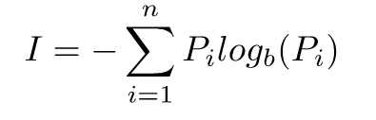
What is computing?
Scary math formula
Shannon’s Equation

Slide 8
What is Quantum Computing?
Quantum computing is essentially harnessing and exploiting the amazing laws of quantum mechanics to process information.
Classical computing: 0 or 1 (seems simple enough, I got this!)
Quantum computing: 0...and 1? :O

Slide 9
Quantum…? Bits…?
Quantum mechanics is as powerful as it is weird. So, how can we use this to our benefit? Much after the advent of quantum mechanics, someone thought, “Oh. What if we use quantum mechanical systems for processing of information?”

Slide 10
Bits! But...quantum?
Classical bits or just bits can have two distinct states, 0 or 1.
Entropy!
Quantum bits on the other hand can be 0 or 1 or anything in-between!
This is possible because of the property of quantum systems called superposition.
Formally… A qubit is a quantum system which represents the smallest unit of quantum information

Slide 11

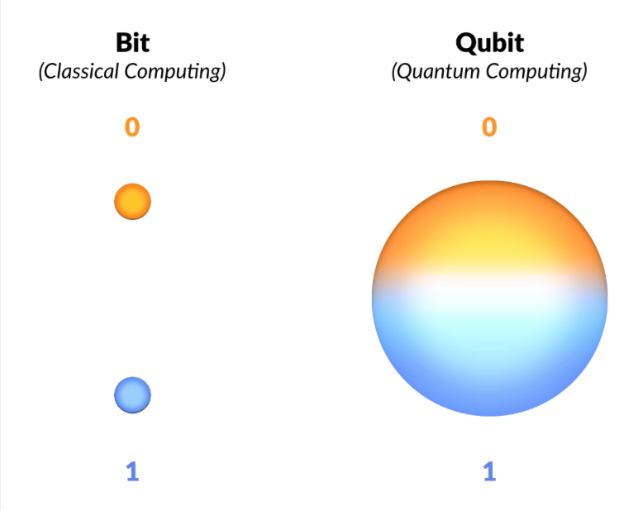
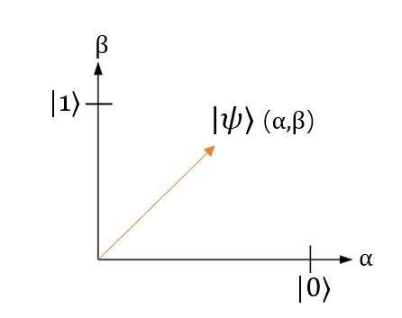
Ohhhh, quantum bits!

Slide 12

Qubits
If you have n qubits then you have 2^{n} computational power
Can any vector be a qubit?

Slide 13
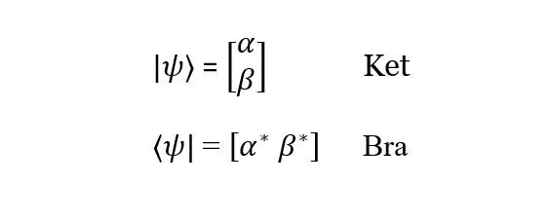
Bra-ket
The ket is the notation we’ve been using to represent quantum states so far (|ψ⟩).
The bra, on the other hand, is the conjugate transpose of the ket and is denoted by 〈ψ|.

Slide 14
Vectors and Vector Spaces
The generic definition is that, vectors are mathematical objects that have both magnitude and direction.
A vector space over a field F is a set of objects (vectors), where two conditions hold
The operation to add two vectors is closed
The operation of multiplying a vector with a scalar is closed
We represent qubits as “state vectors”
There are simply vectors, no different than the one just presented that point to a specific point in space that corresponds to a particular quantum state. Oftentimes, this is visualized using a Bloch sphere. For instance, a vector, representing the state of a quantum system could look something like this arrow, enclosed inside the Bloch sphere, which is the so-called "state" space of all possible points to which our state vectors can "point"

Slide 15
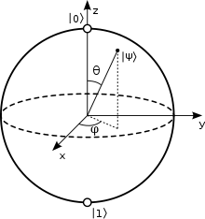
Bloch sphere
Another way to represent a qubit is the bloch sphere representation.
This is a 3D sphere of unit radius and each point on its surface represents a different state.

Slide 16

Wow! That’s quite a lot, you’re almost there!

Slide 17
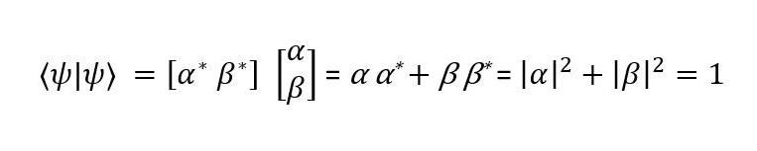
Inner product
Qubits are vectors in a 2^{n} Hilbert space
Geometrically equivalent to the dot product

Slide 18
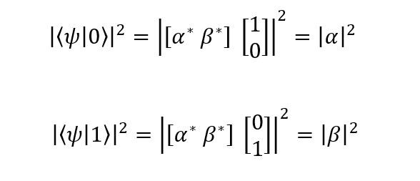
Looking at Schrödinger’s catto 🐈
How do you measure something? And how does this fit in with our trip down physics lane?
The way we measure a qubit in a state|b⟩ is to take the inner product of the qubit with the state in which you want to measure it in and take the modulus of this result and square it.
This gives us the probability that the post-measurement state of the qubit will be |b⟩.

Slide 19
Matrices and why they are important
In linear algebra, think of a matrix as an “operation” that modifies the state of a qubit
Columns of matrices as vectors
Columns are the transformed standard bases when the operation is applied on them
These operations are termed as gates

Slide 20
Gates

Slide 21
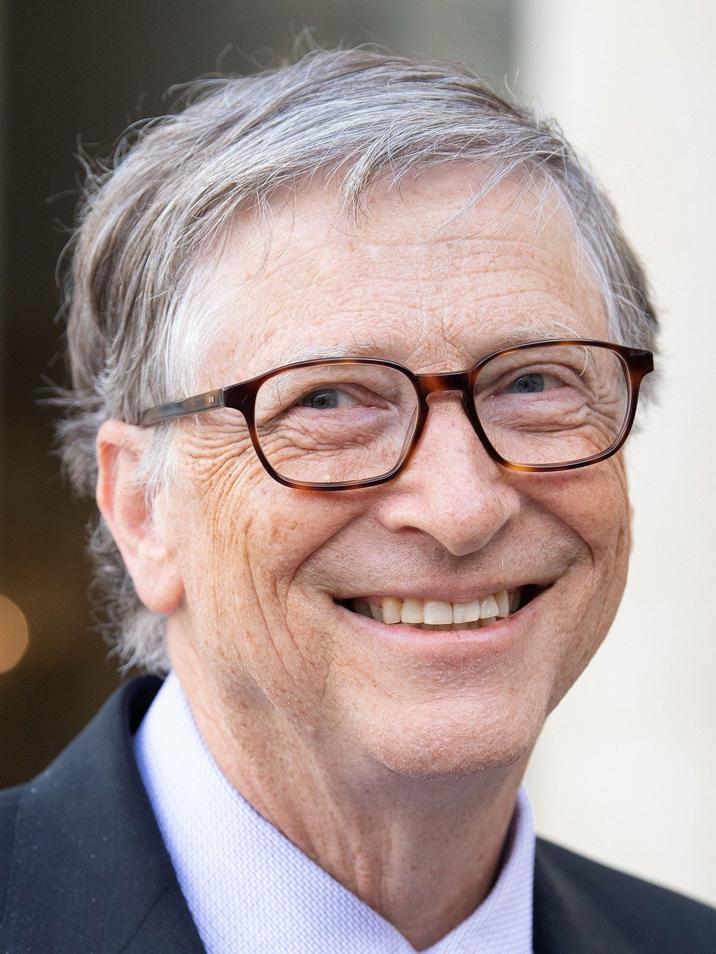
Gates
Hehe, wrong Gates (sorry, was bored)

Slide 22
Classical and quantum gates
What are the differences between the two?
Classical NOT vs classical OR, AND etc
How does it relate to the physics of information?
What are some of the equivalent gates between classical and quantum computing?

Slide 23
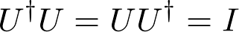
Quantum gates
These are nothing but unitary matrices that change the state of the qubit.

Slide 24
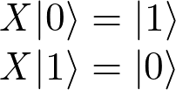
Quantum gates
Pauli X
Equivalent to the classical NOT gate
Flips the standard bases
Has no effect on the Hadamard basis
It rotates the qubit about the X axis on the bloch sphere

Slide 25
Quantum gates
Identity gate
Any qubits when operated on by this gate does not change.
Hadamard gate
Like, the Paulis, the Hadamard is also a half rotation about the Bloch sphere. However, the difference is that it rotates about an axis that is exactly between the X and the Z axes.

Slide 26
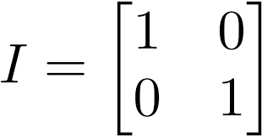
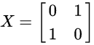
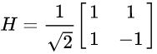
What do they look like?
Matrices!

Slide 27
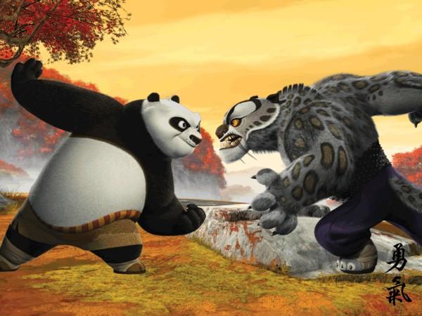
Heads or tails?

Slide 28
Rules
The coin starts with heads facing up
The first move is made by your opponent
The second move is made by you
During these moves, neither you nor your opponent can see the coin
The third move is again made by your opponent
In the end, if there’s tails facing up, you win, else your opponent wins!

Slide 29
Finer details
You can either decide to flip the coin or leave it as it is!
But remember, you can’t see the coin!

Slide 30
Finer details
|0⟩ Heads
|1⟩ Tails

Slide 31
Finer details
Flip Pauli X
No flip Identity

Slide 32
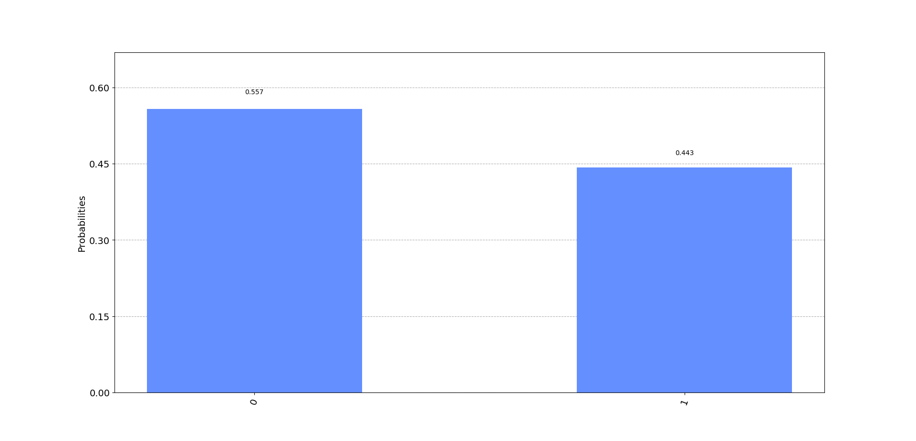
Classical opponent
What happens
if your opponent was
a classical computer?

Slide 33
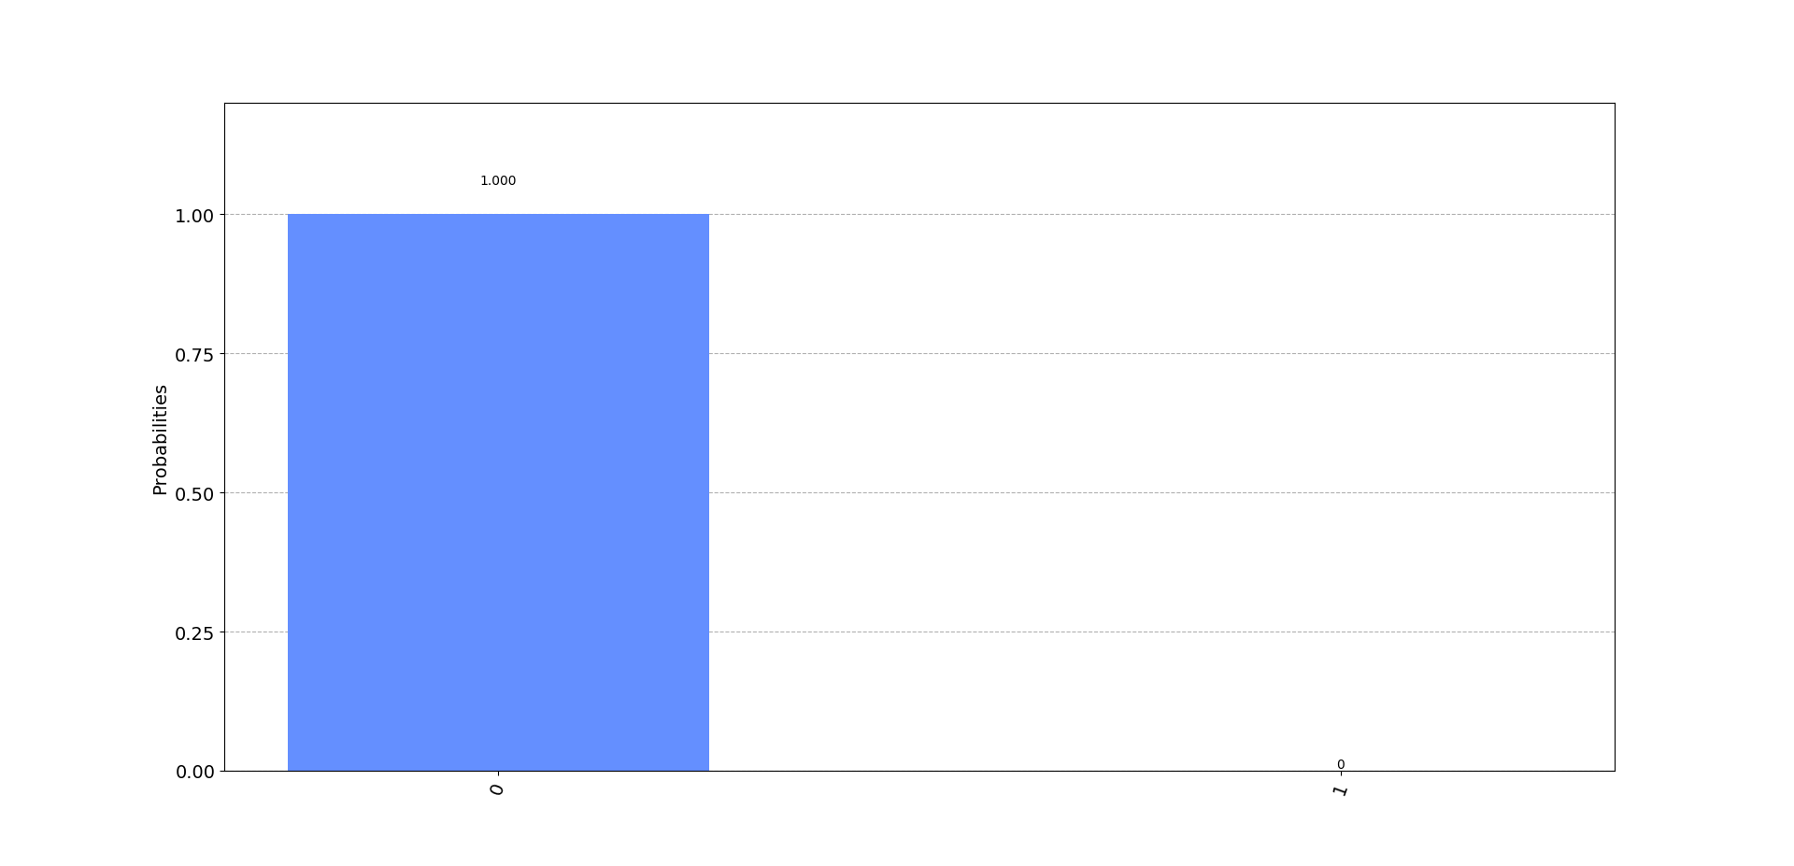
Quantum opponent

Slide 34
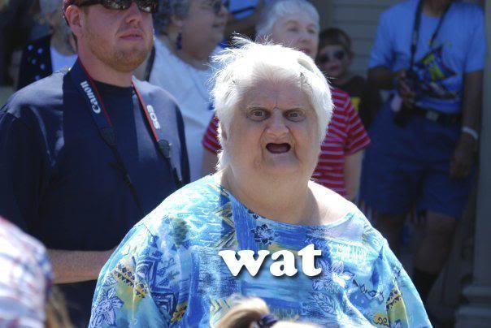
Quantum opponent

Slide 35
How?
X|0⟩ = |1⟩
I|0⟩ = |0⟩
I|1⟩ = |1⟩
H|0⟩ = |+⟩
H|+⟩ = |0⟩
X|+⟩ = |+⟩

Slide 36
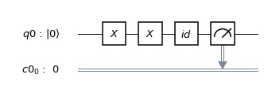
Example

Slide 37
An example
Your opponent flips the coin
You flip the coin
Your opponent decides to leave it as it is
The circuit looks something like this ->

Slide 38
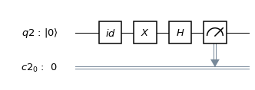
Hadamard, I choose you!
So, this is what your opponent will do if quantum in nature

Slide 39
Thank you!

